Slide 1

Predictive Analytics in Business (BUAN 448)
Cluster Analysis
(Chapter 15)
BUAN 488 – Fall 2022 – Dr. Davoodi

Slide 2
Clustering: The Main Idea
Goal: Form groups (clusters) of similar records
Used for segmenting markets into groups of similar customers

Slide 3
Clustering: Examples
Biologists
Extensive use of classes and subclasses to organize species
Chemistry
Mendeleev’s periodic table of the elements
Market Segmentation
segmented based on demographic and transaction history information
Market Structure Analysis
Claritas, a company, segmented US neighborhoods into 40 clusters using various measures …

Slide 4
Example: Public Utilities
Goal: find clusters of similar utilities
Data: 22 firms, 8 variables
Fixed-charge covering ratio
Rate of return on capital
Cost per kilowatt capacity
Annual load factor
Growth in peak demand
Sales
% nuclear
Fuel costs per kwh

Slide 5
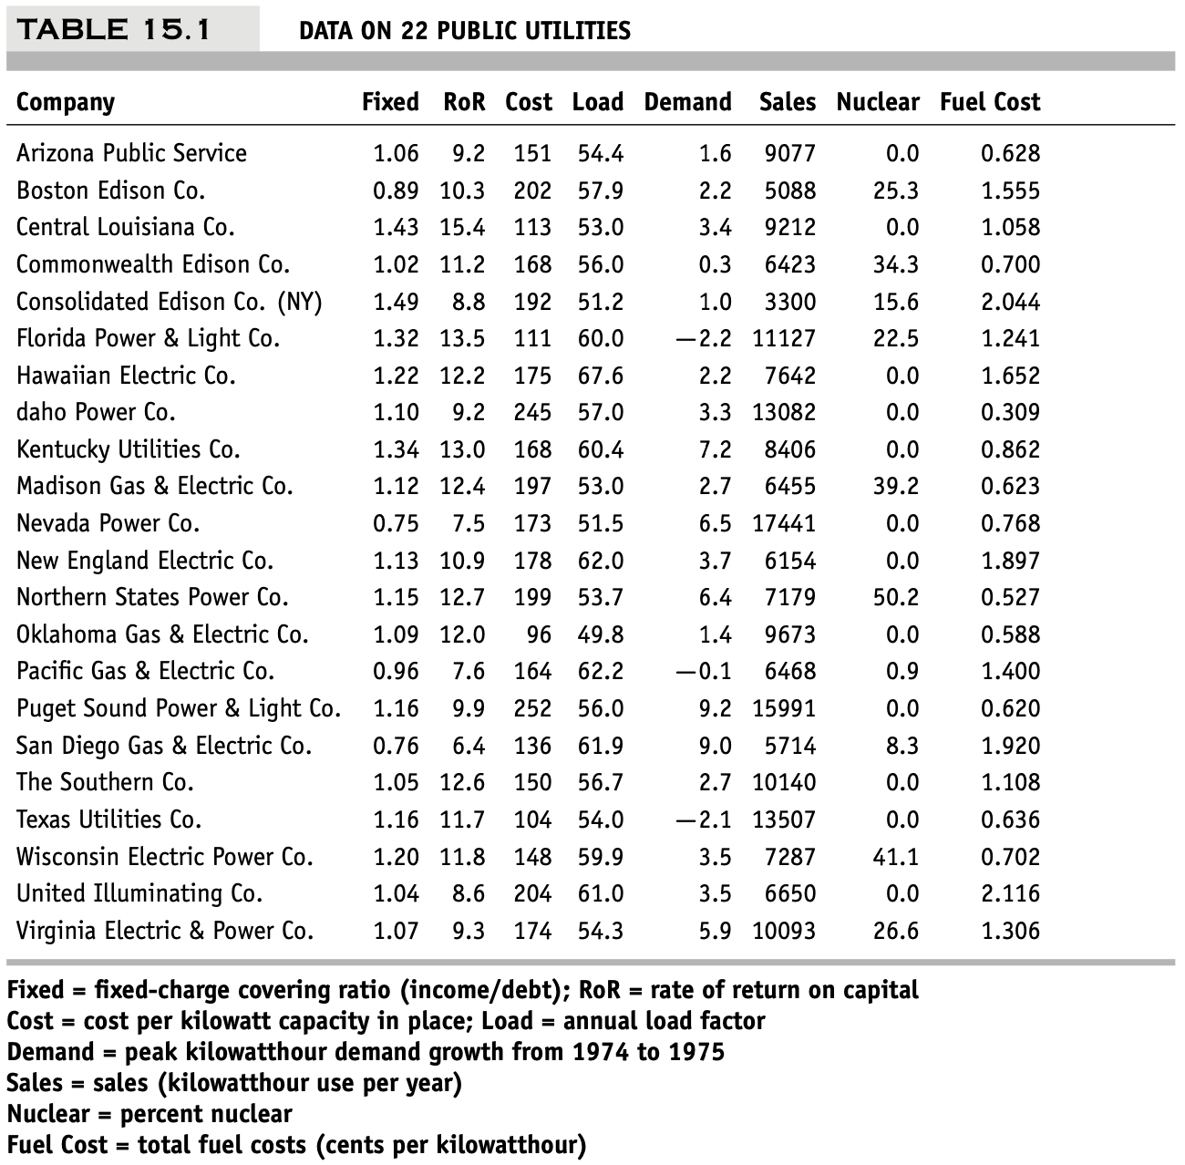
Example: Public Utilities
Corporate data on 22 public utilities in the United States
We are interested in forming groups of similar utilities.
Clustering will be based on the eight measurements

Slide 6
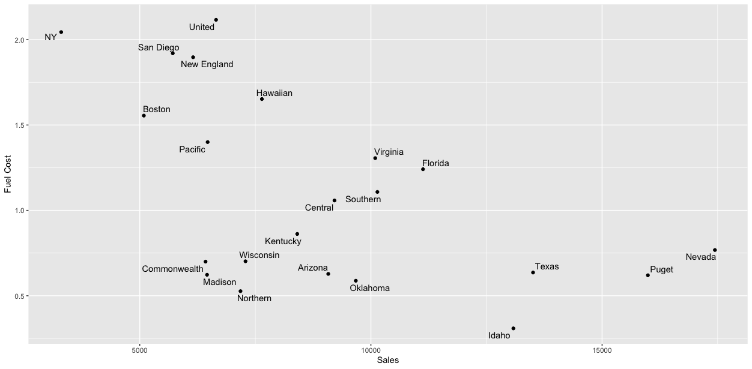
Example: Public Utilities
High fuel cost, Low sales
Low fuel cost, relatively Low sales
Low fuel cost, High sales
Clustering just based on the two measurements

Slide 7
Extension to More Than 2 Dimensions
In prior example, clustering was done by eye
Multiple dimensions require formal algorithm with
A distance measure
A way to use the distance measure in forming clusters
We will consider two algorithms: hierarchical and non-hierarchical

Slide 8
Hierarchical Clustering

Slide 9
Hierarchical Methods
Agglomerative Methods
Begin with n-clusters (each record its own cluster)
Keep joining records into clusters until one cluster is left (the entire data set)
Most popular
Divisive Methods
Start with one all-inclusive cluster
Repeatedly divide into smaller clusters

Slide 10
Measuring Distance
Between records
Between clusters

Slide 11
Measuring Distance Between Records
Notes:
11

Slide 12
Distance Between Two Records
Euclidean Distance is most popular:
Notes:
12

Slide 13
Normalizing
Problem: Raw distance measures are highly influenced by scale of measurements
Solution: normalize (standardize) the data first
Subtract mean, divide by std. deviation
Also called z-scores

Slide 14
Example: Normalization
For 22 utilities:
Avg. sales = 8,914
Std. dev. = 3,550
Normalized score for Arizona sales:
(9,077-8,914)/3,550 = 0.046

Slide 15
Compute Distance Matrix for Utility Pairs
utilities.df <- read.csv("Utilities.csv")
# set row names to the utilities column
row.names(utilities.df) <- utilities.df[,1]
# remove the utility column
utilities.df <- utilities.df[,-1]
# compute Euclidean distance
d <- dist(utilities.df, method = "euclidean")
Could use a variety of metrics here, see R documentation for dist

Slide 16
Code for Normalizing then Computing Distance
scale, without further arguments, normalizes each column
# normalize input variables
utilities.df.norm <- sapply(utilities.df, scale)
# add row names: utilities
row.names(utilities.df.norm) <- row.names(utilities.df)
# compute normalized distance based on Sales (column
6) and Fuel Cost (column 8)
d.norm <- dist(utilities.df.norm[,c(6,8)], method =
"euclidean")

Slide 17
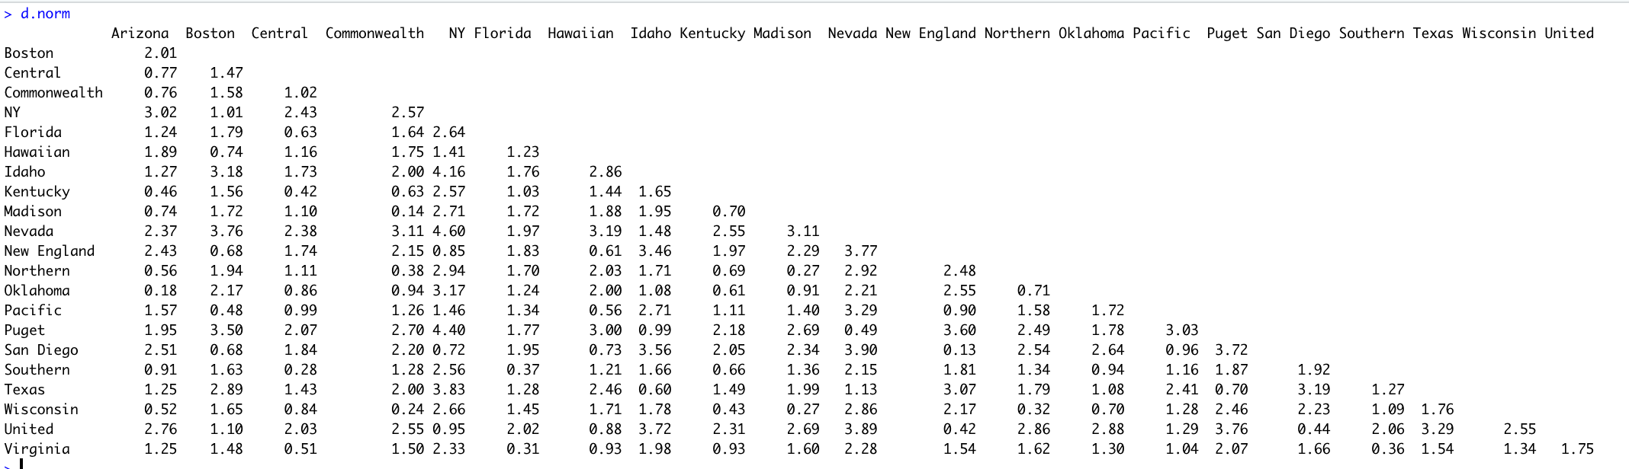
Output of Distance Matrix

Slide 18
Euclidean distance measure
It is highly scale-dependent
It cannot consider unequal weighting if we want the clusters to depend more on certain measurements and less on others.
It ignores the relationship between the measurements
If the measurements are in fact strongly correlated, a different distance (such as the statistical distance, described later) is likely to be a better choice.
Euclidean distance is sensitive to outliers
If removal is not a choice, the use of more robust distances (such as the Manhattan distance, described later) is preferred.

Slide 19
Other Distance Measures
Correlation-based similarity
Statistical distance (Mahalanobis)
Manhattan distance (absolute differences)
Maximum coordinate distance
Gower’s similarity (for mixed variable types: continuous & categorical)

Slide 20
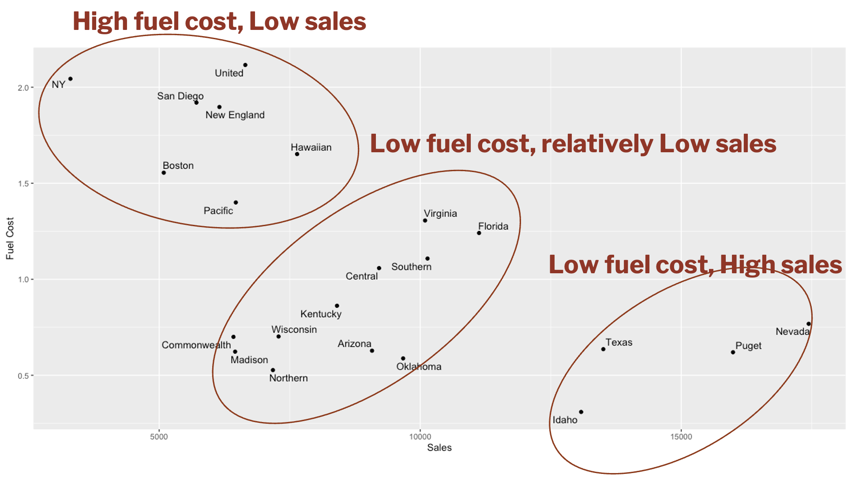
Measuring Distance Between Clusters

Slide 21
Minimum Distance (Cluster A to Cluster B)
Also called single linkage
Distance between two clusters is the distance between the pair of records A_{i} and B_{j} that are closest

Slide 22
Maximum Distance (Cluster A to Cluster B)
Also called complete linkage
Distance between two clusters is the distance between the pair of records A_{i} and B_{j} that are farthest from each other

Slide 23
Average Distance
Also called average linkage
Distance between two clusters is the average of all possible pair-wise distances

Slide 24
Centroid Distance
Distance between two clusters is the distance between the two cluster centroids.
Centroid is the vector of variable averages for all records in a cluster

Slide 25
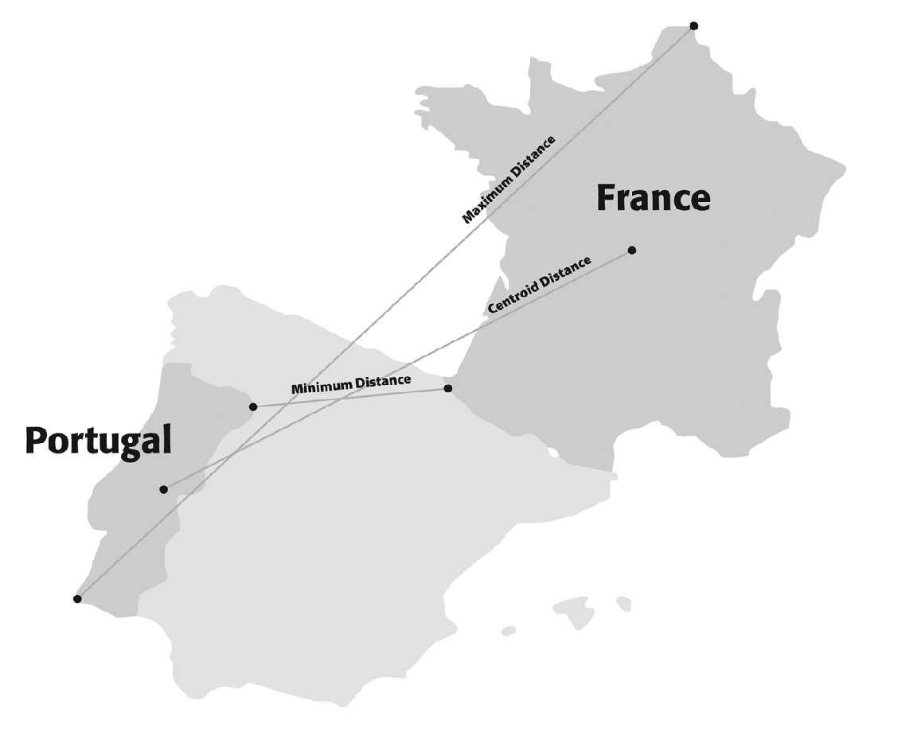
Different Measures

Slide 26
The Hierarchical Clustering Steps (Using Agglomerative Method)
Start with n clusters (each record is its own cluster)
Merge two closest records into one cluster
At each successive step, the two clusters closest to each other are merged
Dendrogram, from bottom up, illustrates the process

Slide 27
Code for Hierarchical Clustering and Plotting the Dendrogram
# in hclust() set argument method =
# to "ward.D", "single", "complete", "average",
"median", or "centroid“
hc1 <- hclust(d.norm, method = "single")
plot(hc1, hang = -1, ann = FALSE)
turns off annotation (plot and axis titles)
causes x-axis labels to hang below the 0 line

Slide 28
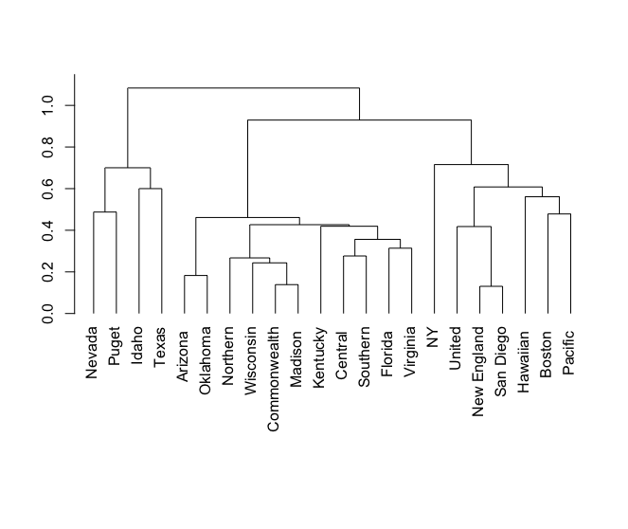
Dendrogram for Single Linkage
Clustering just based on the two measurements

Slide 29
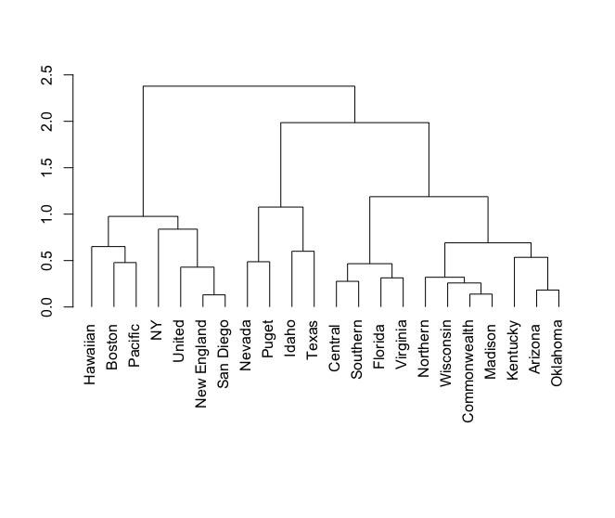
Dendrogram for Average Linkage
Clustering just based on the two measurements

Slide 30
Reading the Dendrogram
See process of clustering: Lines connected lower down are merged earlier
Nevada and Puget will be merged first, then Idaho and Texas
Determining number of clusters: For a given “distance between clusters”, a horizontal line intersects the clusters that are that far apart, to create clusters
E.g., at distance of 0.65 for Single Linkage(red line in next slide), data can be reduced to 5 clusters
At distance of 2.6 for Average Linkage (green line in following slide) data can be reduced to 3 clusters

Slide 31
Dendrogram for Single Linkage
If clusters must be at least 0.65 units apart, then you have 5 clusters

Slide 32
Dendrogram for Average Linkage
At 1.5 units of distance, there are 3 clusters
two closest records form first cluster

Slide 33
Summary
Cluster analysis is an exploratory tool. Useful only when it produces meaningful clusters
Hierarchical clustering gives a visual representation of different levels of clustering
In the next class, we will talk about Hierarchical issues and the other way to cluster observations.

